Slide 1
OpenGL shader & GLSL
2020 Introduction to Computer Graphics

Slide 2
OpenGL pipeline
Vertex
Vertex Shader
Geometry Shader
Rasterizer
Fragment Shader
Frame buffer

Slide 3
Shader
A program designed by users.
Run in GPU pipeline.
Vertex Shader
Geometry Shader
Fragment Shader
Input: Single vertex
Output: Single vertex
Input: One primitive
Output: Can be more than one primitive
Input: One pixel
Output: One or no pixel

Slide 4
Shader
Vertex Shader
Geometry Shader
Fragment Shader
Input: Single vertex
Output: Single vertex
Input: One primitive
Output: Can be more than one primitive
Input: One pixel
Output: One or no pixel

Slide 5
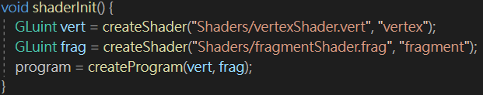
Shader setting
In the function : createShader() (defined in shader.h)
GLuint glCreateShader ( GLenum shaderType );
Specifies the type of shader to be created and creates an empty shader object.
shaderType : GL_COMPUTE_SHADER, GL_VERTEX_SHADER, GL_TESS_CONTROL_SHADER, GL_TESS_EVALUATION_SHADER, GL_GEOMETRY_SHADER, GL_FRAGMENT_SHADER
void glShaderSource ( GLuint shader, GLsizei count, const GLchar **string, const GLint *length );
Sets the source code in shader to the source code in the array of strings specified by string.
Ex : string = & textFileRead("Shaders/example.vert")
void glCompileShader( GLuint shader );
Compile the shader.

Slide 6
Shader setting
In the function : createProgram() (defined in shader.h)
GLuint glCreateProgram(void );
creates a program object.
void glAttachShader (GLuint program, GLuint shader);
Attach the shader object to the program object.
void glLinkProgram ( GLuint program);
Link this program
void glDetachShader ( GLuint program, GLuint shader);
Detaches the shader object from the program object.

Slide 7
Use program
void display() {
glUseProgram(program_id);
/* Shader program effect in this block */
/* Pass parameters to shaders */
glUseProgram(0);
/* Pass 0 to stop the program*/
glUseProgram(another_program_id);
/* Another shader program effect */
glUseProgram(0);
}

Slide 8
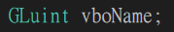
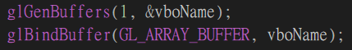
Vertex Buffer Objects (VBO)
Since the vertex shader access only one vertex at one time, we use Vertex Buffer Objects to make the execution be faster. The advantage of using these buffered objects is that we can send a large amount of vertex data from system memory to GPU memory at one time instead of sending it once per vertex.
Step 1 : Use glGenBuffers() to generate vertex buffer objects
void glGenBuffers ( GLsizei n, GLuint * buffers );
n : Specifies the number of buffer object names to be generated.
buffers : Specifies an array in which the generated buffer object names are stored.
Step 2 : Use glBindBuffer() to bind the target buffer, which is GL_ARRAY_BUFFER here.
void glBindBuffer ( GLenum target, GLuint buffer);
target : GL_ARRAY_BUFFER、GL_TEXTURE_BUFFER、…….
buffer : Specifies the name of a buffer object.

Slide 9

Vertex Buffer Objects (VBO)
Step 3 : Set up the data
Step 4 : Use glBufferData() to copy the data into the target.
void glBufferData ( GLenum target, GLsizeiptr size, const GLvoid * data, GLenum usage);
target : GL_ARRAY_BUFFER、GL_TEXTURE_BUFFER、…….
size : Specifies the size in bytes of the buffer object's new data store.
data : Specifies a pointer to data that will be copied into the data store for initialization, or NULL if no data is to be copied.
usage : Specifies the expected usage pattern of the data store. Ex: GL_STATIC_DRAW means the data store contents will be modified once and used at most a few times.

Slide 10
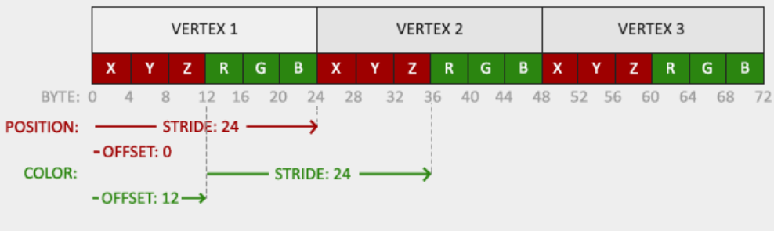
Vertex Buffer Objects (VBO)

Slide 11
Implementation in OpenGL
struct VertexAttribute{ GLfloat position[3]; };
VertexAttribute *vertices;
GLunit vboName;
glGenBuffers(1, &vboName); //generate 1 buffer
glBindBuffer(GL_ARRAY_BUFFER, vboName);
glBufferData(GL_ARRAY_BUFFER, sizeof(VertexAttribute) * vertices_length,
vertices, GL_STATIC_DRAW);

Slide 12
Vertex Attribute Pointer
We can use glVertexAttribPointer() to link the vertex buffer with the vertex shader input.
void glVertexAttribPointer ( GLuint index, GLint size, GLenum type, GLboolean normalized, GLsizei stride, const GLvoid * pointer);
index : Specifies the index of the generic vertex attribute to be modified.
size : Specifies the number of components per generic vertex attribute.
type : Specifies the data type of each component in the array. Ex: GL_FLOAT
normalized : Specifies whether fixed-point data values should be normalized or not.
stride : Specifies the byte offset between consecutive generic vertex attributes.
pointer : Specifies a offset of the first component of the first generic vertex attribute in the array in the data store of the buffer currently bound to the GL_ARRAY_BUFFER target. The initial value is 0.

Slide 13
Vertex Attribute Pointer
glEnableVertexAttribArray(0);
glVertexAttribPointer(0,
3,
GL_FLOAT,
GL_FALSE,
sizeof(VertexAttribute), // stride
(void*)(offsetof(VertexAttribute, position)));
layout(location = 0) in vec3 in_position;
OpenGL
GLSL (vertex shader)

Slide 14

Unbind the VBO
Use glBindBuffer() with the buffer set to zero to unbind the target buffer.

Slide 15
Vertex Array Object (VAO)
If you want to render more than one objects, you have to repeat above steps (slides 8 ~14).
very troublesome
Use VAO(Vertex Array Object) to handle this problem.
First, you have to set up all the VAOs with its corresponding VBO, including all VertexAttributePointer. After that, every time you want to render a certain object, you just need to bind its VAO.

Slide 16
Vertex Array Object (VAO)
VAO 1
VBO 1
Vertex 1
Vertex 2
Vertex 2
………….
Attribute pointer 0
………….
X
Y
Z
R
G
B
S
T
X
Y
Z
R
G
B
S
T
Attribute pointer 1
Attribute pointer 2
…….
VBO 2
VAO 2
Vertex 1
Vertex 2
………………….
Attribute pointer 0
X
Y
Z
X
Y
Z
Attribute pointer 1
Attribute pointer 2
…….

Slide 17
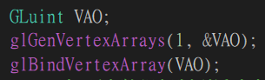
Vertex Array Object (VAO)
Step 1 : Use glGenVertexArrays() to generate vertex array objects
void glGenVertexArrays ( GLsizei n, GLuint * arrays );
n : Specifies the number of vertex array object names to be generated.
arrays : Specifies an array in which the generated vertex array object names are stored.
Step 2 : Use glBindVertexArray() to bind a vertex array object.
void glBindVertexArray ( GLuint array)
array : Specifies the name of the vertex array to bind.

Slide 18
Vertex Array Object (VAO)
Step 3 : Setting up its corresponding VBO, for example :
glBindBuffer(GL_ARRAY_BUFFER, VBO);
glBufferData(GL_ARRAY_BUFFER, sizeof(vertices), vertices, GL_STATIC_DRAW);
glVertexAttribPointer(0, 3, GL_FLOAT, GL_FALSE, 3 * sizeof(GLfloat), (GLvoid*)0);
glEnableVertexAttribArray(0);
Step 4 : Use glBindVertexArray (0) with the array’s name set to zero to unbind the array object.
void glBindVertexArray ( GLuint array)
Ex: glBindVertexArray(0) means to unbind the VAO previously bound.

Slide 19
When Rendering
Step 1 : Use glBindVertexArray(VAO) to bind the VAO you want.
Step 2 : Use glDrawArrays() to render primitives from vertex array data.
void glDrawArrays() ( GLenum mode, GLint first, GLsizei count);
mode : Specifies what kind of primitives to render. Ex: GL_POINTS, GL_LINES, GL_TRIANGLE_STRIP……
first : Specifies the starting index in the enabled arrays.
count : Specifies the number of indices to be rendered.
Step 3 : Remember to unbind the VAO. ( glBindVertexArray(0) )
*Every time you want to render another object, you just need to bind another VAO.

Slide 20
Data Connection - Uniform
GLfloat pmtx[16]; //getP(), getV()
glGetFloatv(GL_PROJECTION_MATRIX, pmtx);
GLint pmatLoc = glGetUniformLocation(program, "Projection");
glUseProgram(program);
glUniformMatrix4fv(pmatLoc, 1, GL_FALSE, pmtx);
glUseProgram(0);
uniform mat4 Projection;
OpenGL
GLSL (vertex shader)

Slide 21
Data Connection - Texture
glUseProgram(program);
glActiveTexture(GL_TEXTURE0);
glBindTexture(GL_TEXTURE_2D, texObj);
GLint texLoc = glGetUniformLocation(program, "Texture");
glUniform1i(texLoc, 0);
/* draw objects */
glBindTexture(GL_TEXTURE_2D, 0);
glUseProgram(0);
layout(binding = 0) uniform sampler2D Texture;
in vec2 texcoord;
out vec4 outColor;
void main() { outColor = texture2D(Texture, texcoord); }
OpenGL
GLSL (fragment shader)

Slide 22
GLSL Syntax
Basic Variable Types
vec2, vec3, vec4, …
mat2, mat3, mat4, …
float, int, bool, …
sampler2D, …
Basic Functions
max, min, sin, cos, pow, log, …
dot, normalize, reflect, …
transpose, inverse, …

Slide 23
Vertex Shader
/* Example of vertex shader */
#version 430
layout(location = 0) in vec3 position;
uniform mat4 Projection;
uniform mat4 ModelView;
out vec3 color; //to fragment shader
void main() {
gl_Position = Projection * ModelView * vec4(position, 1.0);
color = vec3(1.0, 0.0, 0.0);
}
must have gl_Position

Slide 24
Fragment Shader
must have a out vec4 for color buffer
/* Example of fragment shader */
#version 430
in vec3 color; //from vertex shader
out vec4 frag_color;
void main() {
frag_color = vec4(color, 1.0);
}

Slide 25
Program
Vertex shader
Fragment shader
EBO
VAO
VAO
VAO
indices
output
VBO
VBO
VBO
Point data

Slide 26
Texture in OpenGL

Slide 27
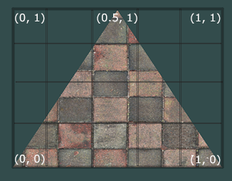
Texture coordinate

Slide 28
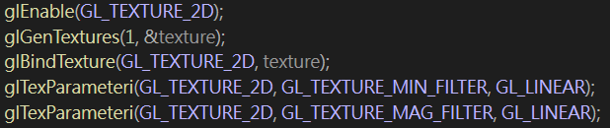

How to load and bind a texture
void glEnable(Glenum cap);
Use GL_TEXTURE_2D to enable texture
Use FreeImage library to load and free texture memory
void glGenTextures( GLsizei n, GLuint * textures);
Takes as input how many textures we want to generate and stores them in a unsigned int array
void glBindTexture( GLenum target, GLuint texture);
Bind a named texture to a texturing target
void glTexImage2D( GLenum target, GLint level, GLint internalformat, GLsizei width, GLsizei height, GLint border, GLenum format, GLenum type, const GLvoid * data);
Generate a two-dimensional texture image

Slide 29
How to load and bind a texture
void glTexParameteri( GLenum target, GLenum pname, GLint param);
Texture wrapping
Texture coordinates usually range from (0,0) to (1,1) but if we specify coordinates outside this range, the default behavior of OpenGL is to repeat the texture images
glTexParameteri(GL_TEXTURE_2D, GL_TEXTURE_WRAP_S, GL_REPEAT);
glTexParameteri(GL_TEXTURE_2D, GL_TEXTURE_WRAP_T, GL_REPEAT);
Texture filtering
Texture coordinates do not depend on resolution but can be any floating point value, thus OpenGL has to figure out which texture pixel to map the texture coordinate to
glTexParameteri(GL_TEXTURE_2D, GL_TEXTURE_MIN_FILTER, GL_Nearest);
glTexParameteri(GL_TEXTURE_2D, GL_TEXTURE_MAG_FILTER, GL_LINEAR);

Slide 30

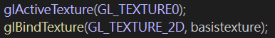
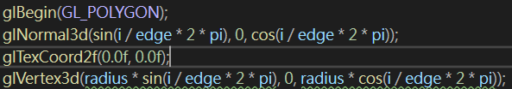
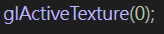
How to use
Step 1 : Use glActiveTexture(GL_TEXTURE0) to activate the texture unit
Texture unit GL_TEXTURE0 is always by default activated
Step 2 : Use glBindTexture (GL_TEXTURE_2D, texture_name) to bind the texture which you want to use.
Step 3 : Use glTexCoord2f(s, t) to define the point’s texture coordinate
Step 4 : give the point (usually using glVertex3f or glVertex3d)
Texture you load before

Slide 31
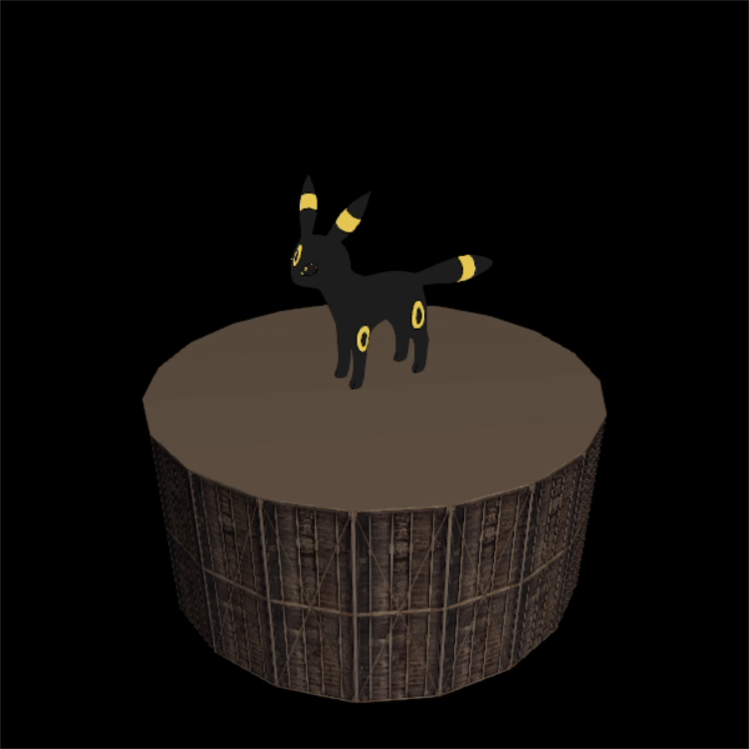
Homework 2 - Music Box with no music

Slide 32
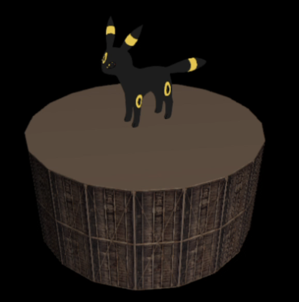
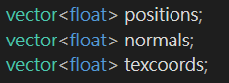
Homework 2
Goal :
Using GLSL to draw
Using OpenGL to draw
Some parameters will be used (define in Object.h)
Position : model->positions
Normal : model->normals
Texcoords : model->texcoords

Slide 33
Homework 2 (配分)
1. createShader, createProgram (5%)
2. Setup VAO, Setup VBO of vertex positions, normals, and texcoords (20%)
3. draw the basis and make the side of basis with texture (10%)
#There is no requirement for the top and bottom colors
#use OpenGL to draw , not need to use shader
4. pass projection matrix, and view matrix and trigger by Uniform (use getP() amd getV()) (5%)
also pass modeltexture to shader and trigger by Uniform (20%)
5. vertex shader (10%)
#normal will not be used in this homework, but you have to receive from bind buffer in the vertex shader and pass to fragment shader
6. fragment shader (10%)
7. report (20%)
8. # Bonus (5%) Using shader to do anything you want is welcomed ☺

Slide 34
Homework 2 (report)
Please specify your name and student ID in the report.
Explain in detail how to use GLSL by taking screenshots.
(first create program ,second create VAO and VBO, third bind together......etc.)
Describe the problems you met and how you solved them.
Explain what you do for the Bonus. (optional)

Slide 35
Homework 2 (繳交規則)
DeadLine: 2020/ 11 / 30 23: 59:59
Penalty of 10% of the value of the assignment per late week.
If you submit your homework late, the score will be discounted.
submit between (12/1 - 12/7) : Your final score * 0.9
submit between (12/8 - 12/14) : Your final score * 0.8
submit after 12/14 : Your final score * 0.7

Slide 36
Restrictions !!
Your GLSL version should >= #version 330
Deprecated shader syntaxes are not allowed, e.g. attribute, varying
You are only allowed to use VBO and/or VAO when rendering model
You are only allowed to pass uniform data to shader using glUniform* series function
Using built-in uniform variables in shader is forbidden!
(That is, you cannot use gl_ModelViewMatrix or gl_NormalMatrix …etc)
The only gl_XXX term should be in your shader code is gl_Position.

Slide 37
Upload Format
If your uploading format doesn’t match our requirement, there will be penalty to your score. (-5%)
Please hand in the whole project file and report (.pdf) as STUDENTID_Name.zip ​ to e3 platform.
e.g. 0716XXX_王小明.zip
#project file要載下來就可以demo

Slide 38

Reference
https://learnopengl.com/Advanced-OpenGL/
https://learnopengl.com/Getting-started/Textures
https://www.khronos.org/opengl/wiki/Built-in_Variable_(GLSL)

